Slide 1
Microservices and DevOps
Scalable Microservices
Event Sourcing
Henrik Bærbak Christensen

Slide 2
Motivation
Many (most?) large IT systems we use, we use to store information
Permanently or transiently
Data Integrity:
Data integrity refers to maintaining and assuring the accuracy and consistency of data over its entire life-cycle, and is a critical aspect to the design, implementation and usage of any system which stores, processes, or retrieves data. [Wikipedia]

Slide 3
Antipattern
Dropbox
In our housing cooperative (andelsboligforening) we use dropbox to store our resumes from meetings
Board meetings, common meetings, general assembly, …
Benefits
All have instant access to full history
Liabilities
While I was writing these slides, Lars began deleting old resumes on his home computer
Thanks for the ‘restore’ facility!

Slide 4
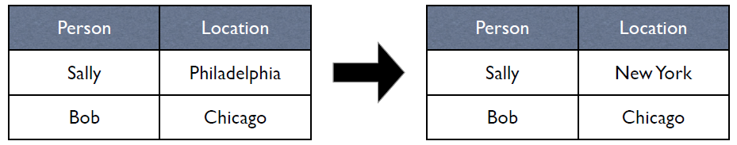
Another example
A regular RDB
Too many courses teach students to store state
Events are handled by state changes
Event: Sally moves to New York
Update in the Sally tuple
Liability in this approach?
Figures from Marz’s GOTO 2012 slides
Notes:
Not resilient to errors: Human operator error (type Aarhus instead of New York), programming error (update method chops last character of the location), Heizenbugs (out of disk error whilst updating the tuple)

Slide 5
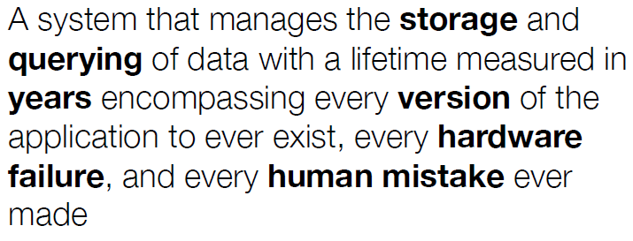
Nathan Marz
Definition of Data System

Slide 6
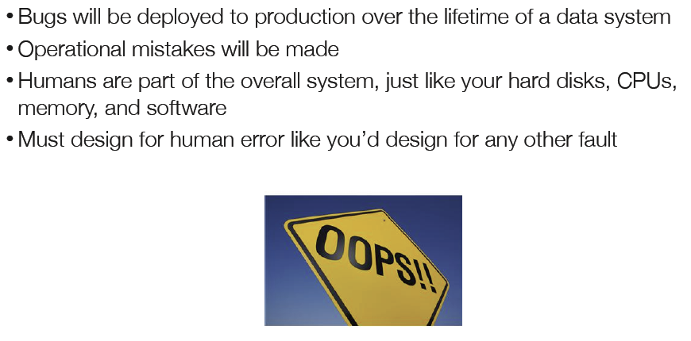
Human fault-tolerance
Nygard: ”Oh-no-second”

Slide 7
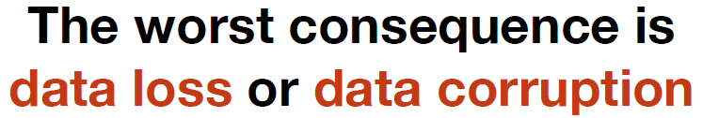
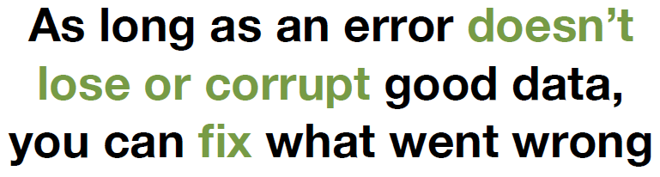
Good or bad
The bad
The good

Slide 8
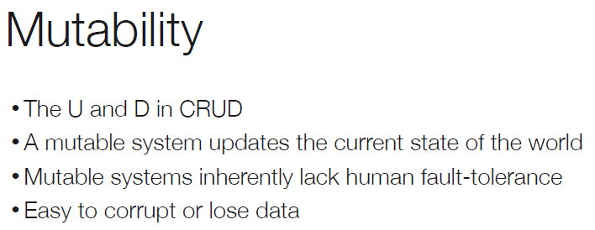
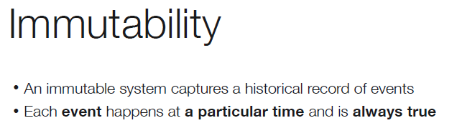
CRUD

Slide 9

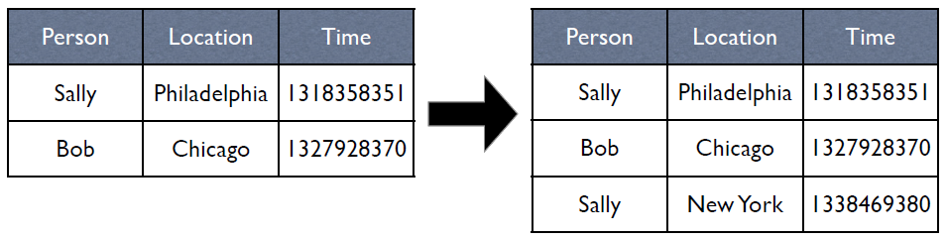
‘Event Sourcing’ Pattern
Capture events as events
State is computed from the history of events

Slide 10
Exercise
Consider how to repair
Human error: I typed Aarhus instead of New York
Program error: Alg. chopped last character of location
Hw error: out-of-disk during tuple insert

Slide 11
Examples
Telemedicine – New Danish standard format
PHMR: Clinical document
Stores all information about a given event
Like a single measurement of blood pressure
Error – insert new event of type ‘correction’ in store
Karibu in EcoSense
Stores the raw measurement events
In a next-to-impossible-to-query format
But raw data integrity is guaranties

Slide 12
Discussion
This is simply too slow!
To draw a blood pressure graph for Nancy you have to fetch, de-XML and combine 30 huge documents!
Yep. But how to solve this?
This consumes much more disk space!
Yep. There is no free lunch…
Notes:
We can run data-mining processes that build ‘caches’ of state. These are volatile, may be deleted at any time. Still the liability is

Slide 13
Outlook
Marz: Lambda-architectures
Run batch processing for historic events to produce fast query databases
Combine with live processing of current events (like last 24 hours) to augment the above query database

Slide 14
Summary
To ensure data integrity (reliable data in face of all types of errors) of a data system (one that stores data over large time spans), you should
Store events and not state
Overwritten state is lost state
Events can be corrected – by new events
Old events are not lost
Performance penalty can be mitigated by deriving state and store it separately…

